Slide 1
Waste COLLECTION SYSTEM
Here is where our presentation begins.
You are Welcome!!!!

Slide 2


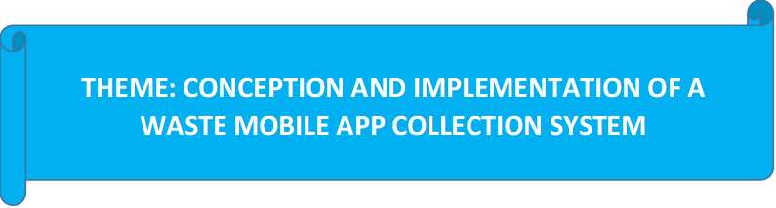
REPUBLIC OF CAMEROON
Peace - Work - Fatherland
REPUBLIQUE DU CAMEROUN
Paix – Travail - Patrie
AFRICAN INSTITUTE OF COMPUTER SCIENCES - CAMEROON OFFICE
PAUL BIYA TECHNOLOGICAL CENTER OF EXCELLENCE
P.O. Box: 13719 Yaoundé
Tel: +237.242.729.957 Fax: 22729958
E-mail: contact@iaicameroun.com
Web site: www.iaicameroun.com
THINK BIG, START SMALL, START NOW
Tel: (237) 620256960/654486985
Email: realize.contactus@gmail.com
Web site: www.realize.cm
Internship carried out from the 03rd of July till the 30th of September 2024. In view of obtaining a Software Engineering Diploma in Computer Sciences Option: Software Engineering
Written by:
NSAN SAMUEL PENIEL
Level II Software Engineering student
Supervision
Professional Supervisor:
Mr. MENGOT NSO
Software Engineer at REALIZE
Academic Supervisor:
Mr. ASSANE DERICK
Lecturer at AICS-Cameroon
Academic Year 2024 - 2025

Slide 3
Presentation Plan
01
Introduction
02
Context and Problematic
03
Methodology
04
Demonstration
05
Conclusion

Slide 4
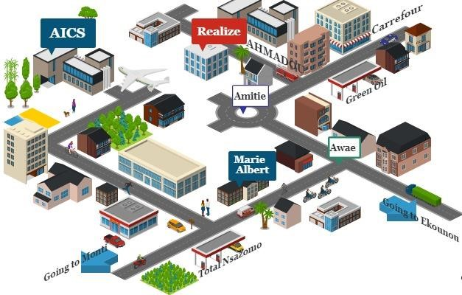
GENERAL PRESENTATION OF REALIZE
GEOGRAHICAL LOCATION
A. History
Realize is a Cameroon-based NGO and tech start-up founded by Mr. NDELOGAKEH DANIEL in 2022. It offers IT solutions and promotes the use of new technologies in Cameroon.
B. Vision
Realize believes that unlocking the potential of organizations and individuals is possible through analysis, development, realization, and data analytics.
REALIZE is located at Yaoundé Valler Amadou Ekie

Slide 5
Challenges faced by our societies due to waste management
CONTEXT / STATISTICS
Problem breakdown across all cities in percentages:
Public Health Risks – 26.4%
Environmental Impact – 22.7%
Social Impact – 19.4%
Collection Rate – 10.4%
Governance Issues – 9.7%
Operational Capacity – 6.9%
Financial Stability – 4.5%
In Yaoundé a certain amount of 1800 tons of waste daily.
Cameroon generates 6M tones of waste annually.
👉 This shows that health and environment issues are the biggest consequences, making up nearly half (49.1%) of all Hysacam’s problems.

Slide 6
CONTEXT (HISTORY)
Some Consequences of uncollected waste disposal
1. Public Health Risks
Spread of Diseases(mosquitoes → malaria, cholera, typhoid, dengue)
Respiratory Issues(gases, dust, particulate matter).
Water Contamination(waterborne diseases)
2. Social/Environmental Impact
Unpleasant Living Conditions (odors, unsightly surroundings)
Water Pollution (chemicals/plastics → rivers, lakes, oceans)
Air Pollution (open burning → dioxins)
3. Governance Issues
Inefficient Policies
Corruption / Mismanagement

Slide 7
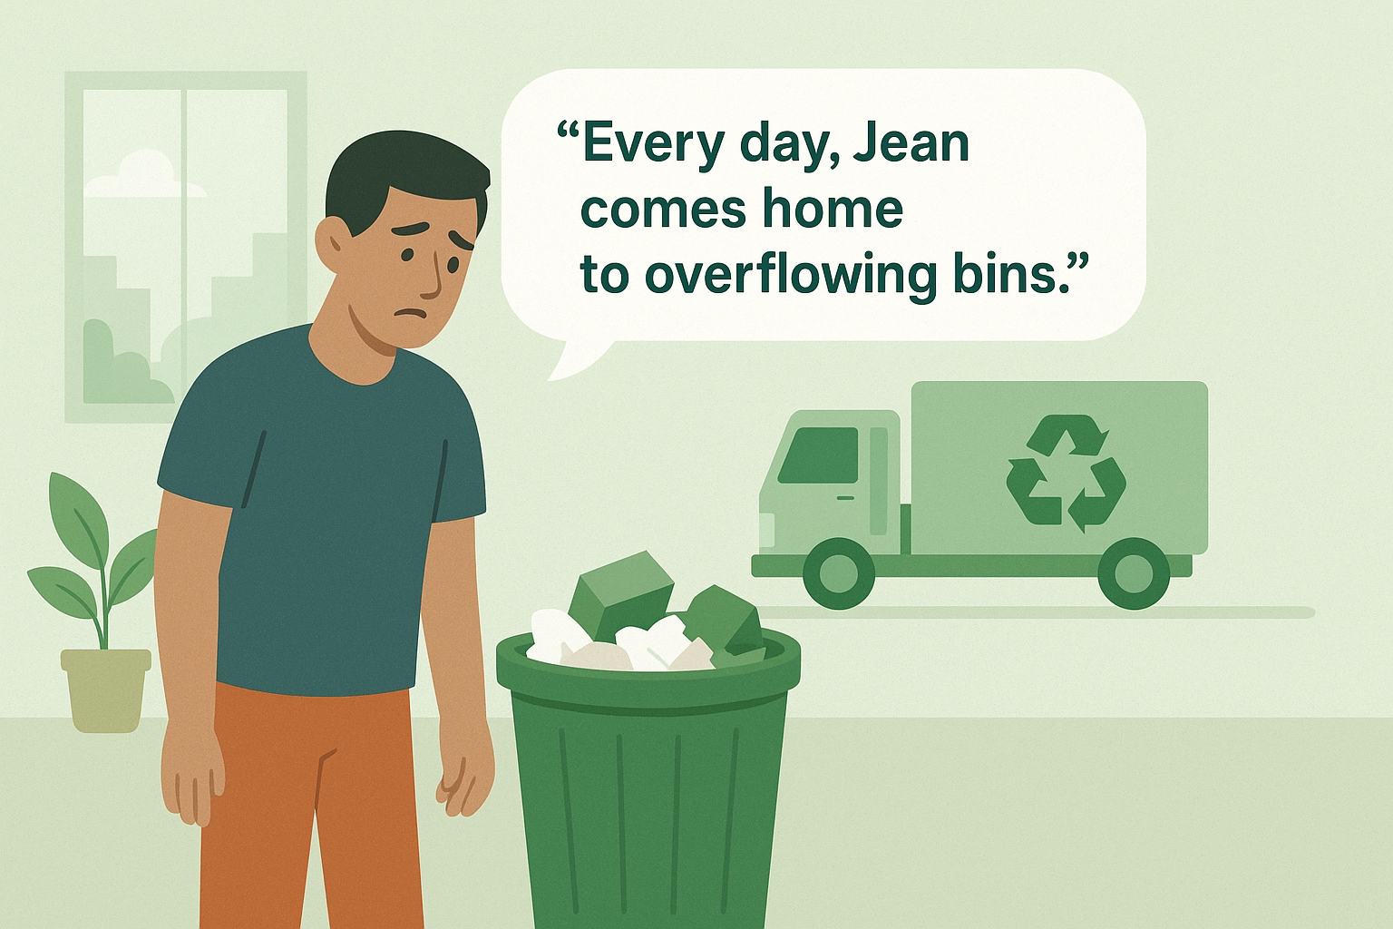
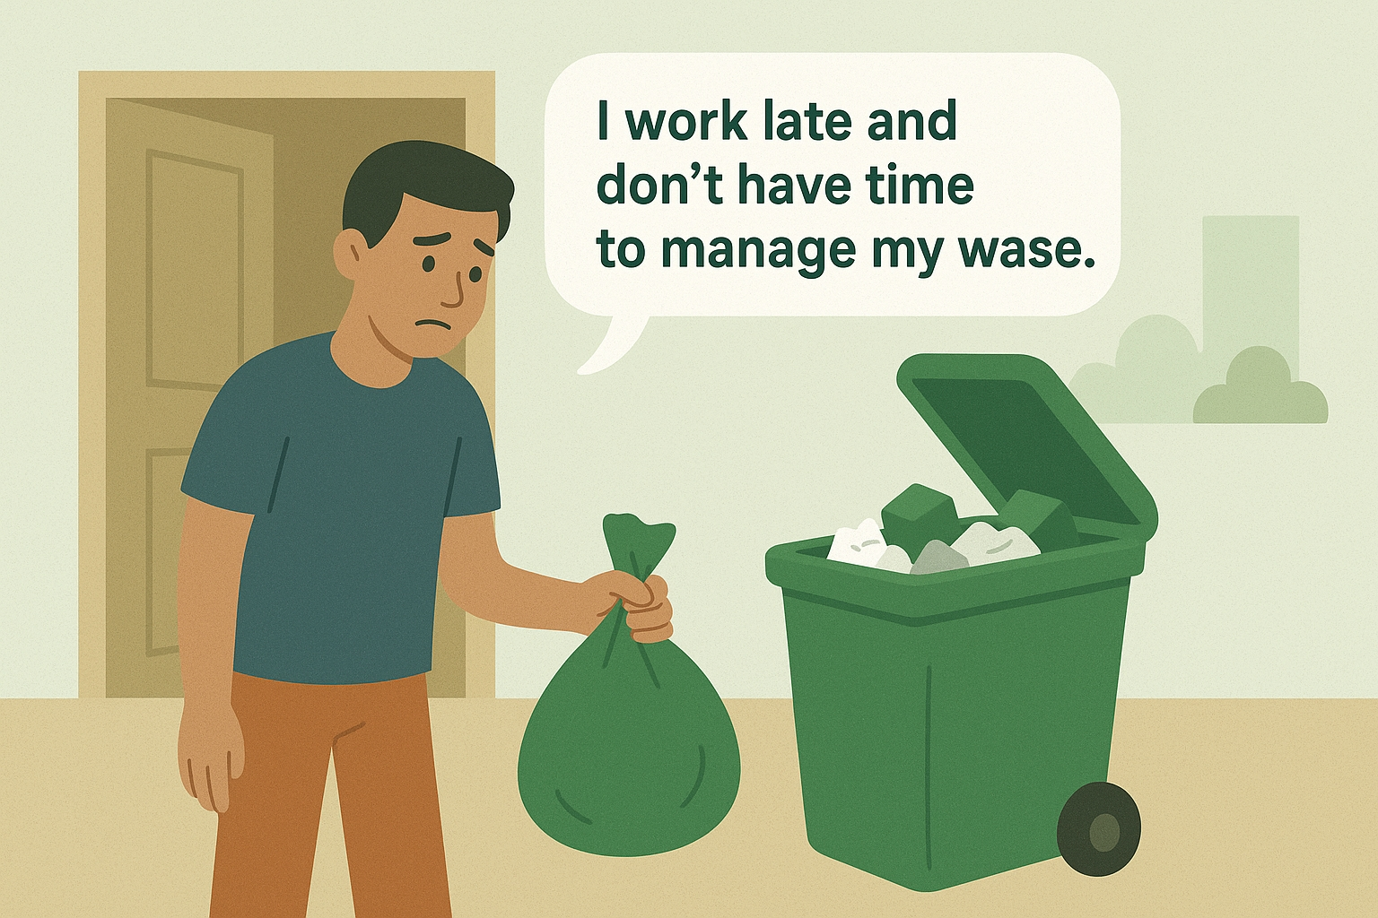
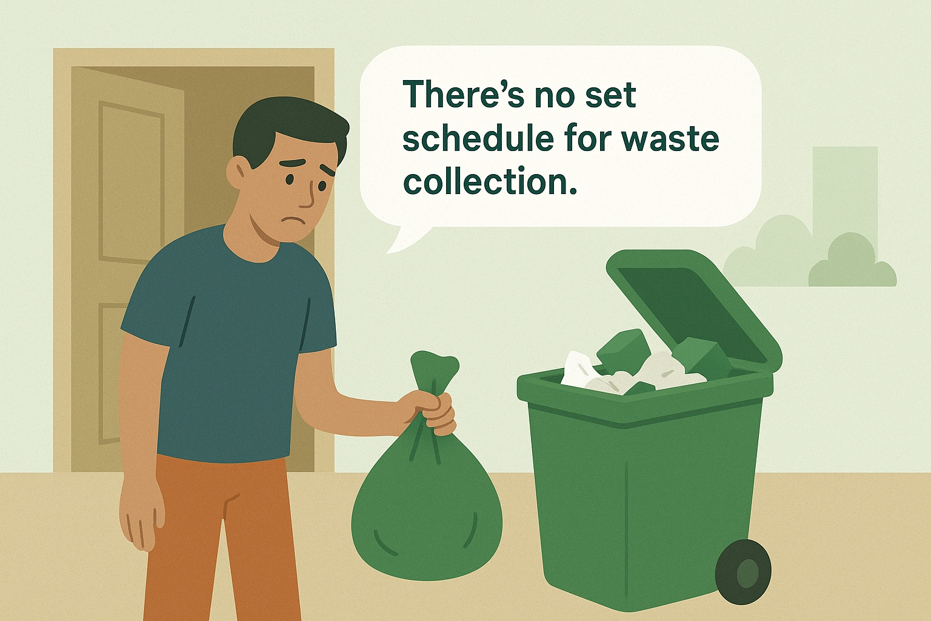
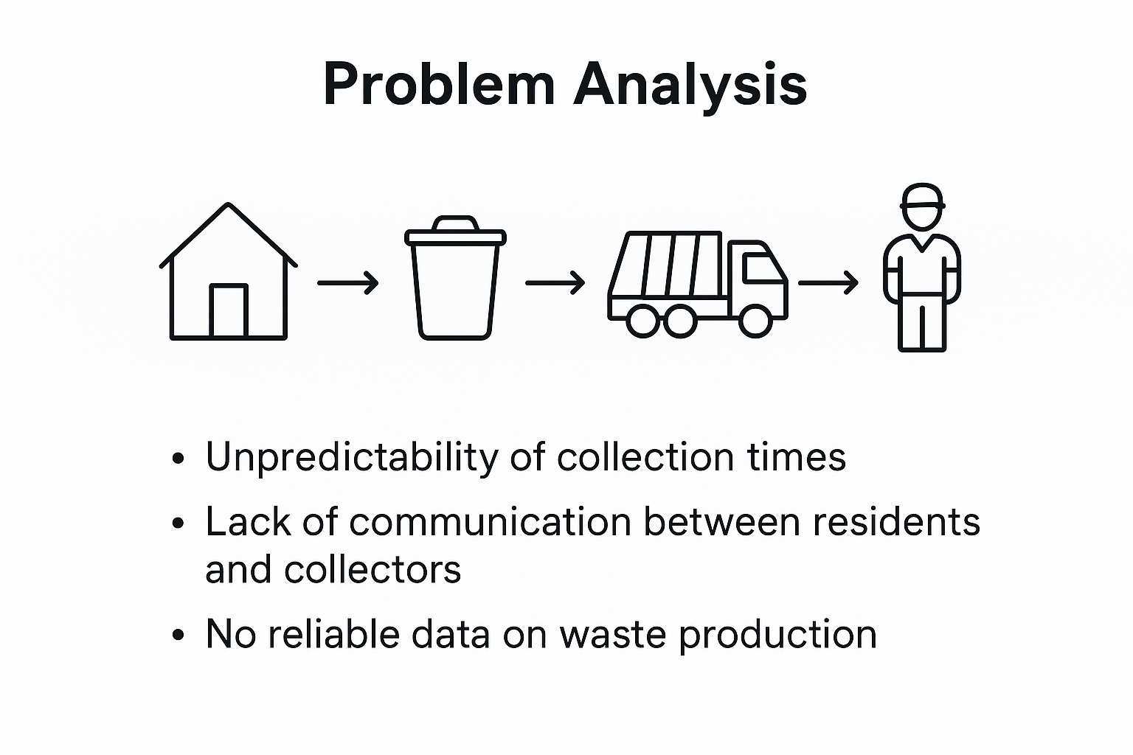

Slide 8
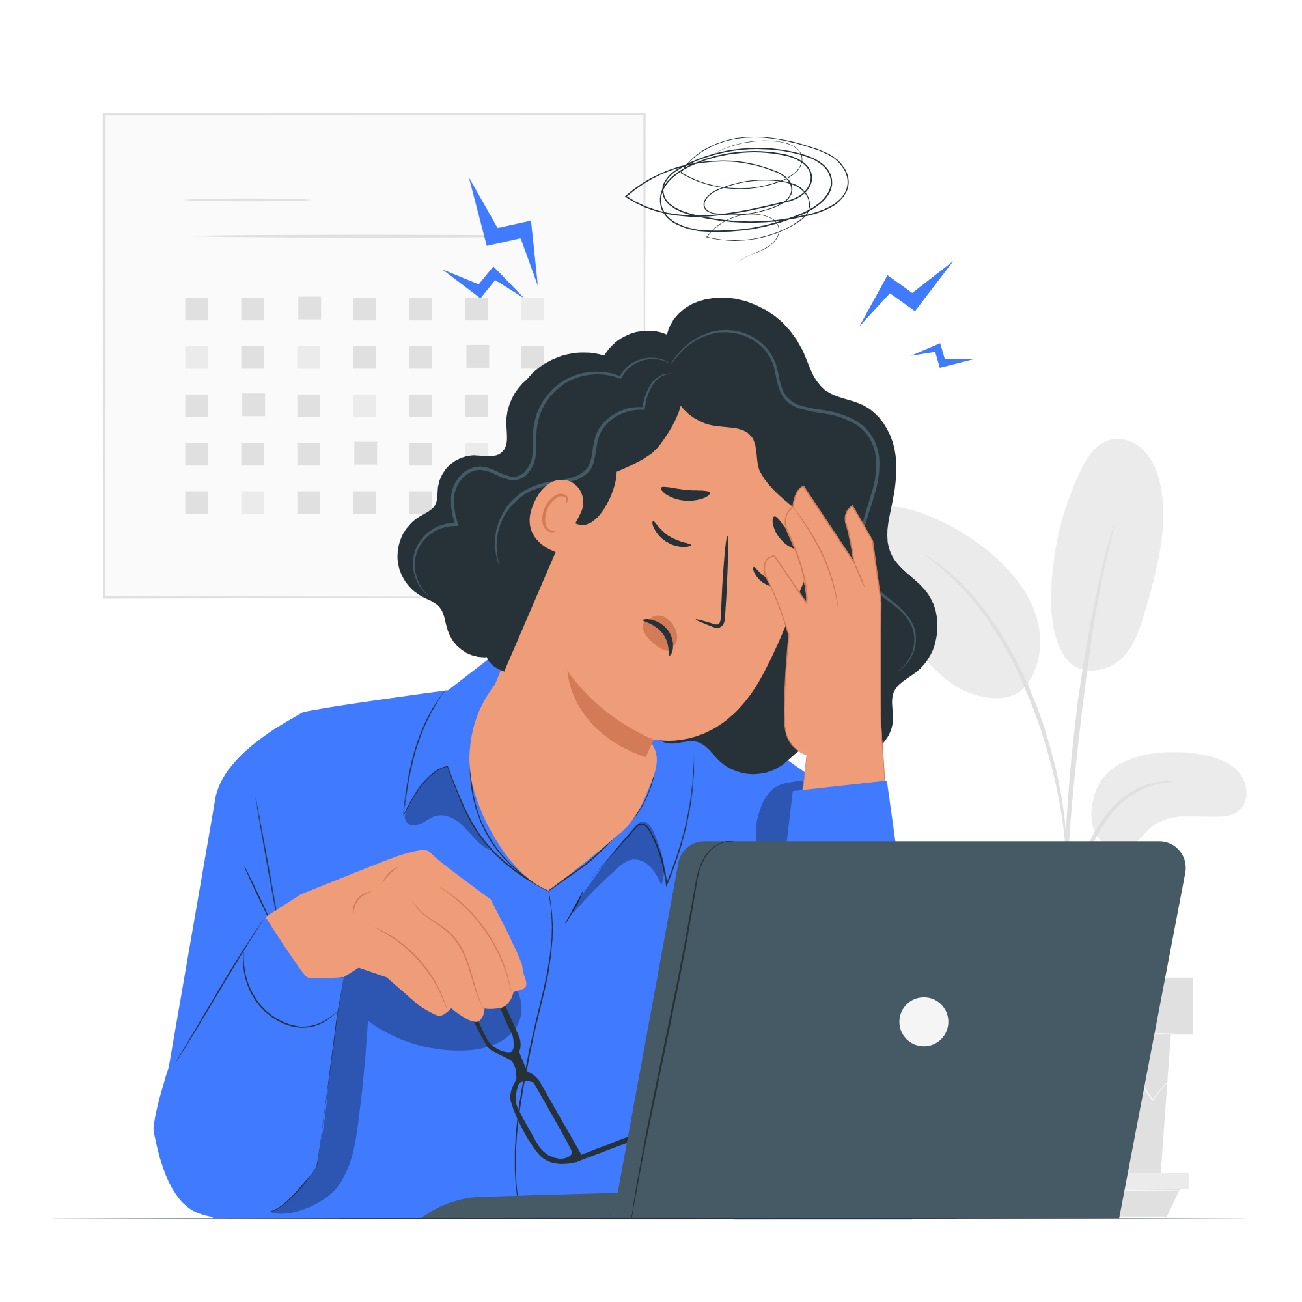
Problematics
In our communities, we are all familiar with the sight of uncollected waste and the resulting nuissance.
This poses a critical question?
“How can we solve the problem of inefficient waste collection that leads to environmental pollution and public health hazards?.....”

Slide 9

Proposed Solutions
The solution is a digital waste collection system which is Zerodech, that combines a mobile app, GPS tracking, payment integration, and intelligent pickup scheduling. It aims to increase efficiency, transparency, and accessibility while reducing the limitations of manual collection in hard-to-reach areas.
Mobile Application for Residents
Develop a user-friendly app allowing residents to register, subscribe, and make payments.
Real-Time Location Tracking
Use GPS APIs to track households’ locations, especially in hard-to-reach or inaccessible areas.
Digital Subscription and Payment
Maintain a database of subscribers, tracking payment status and subscription history in real time.

Slide 10
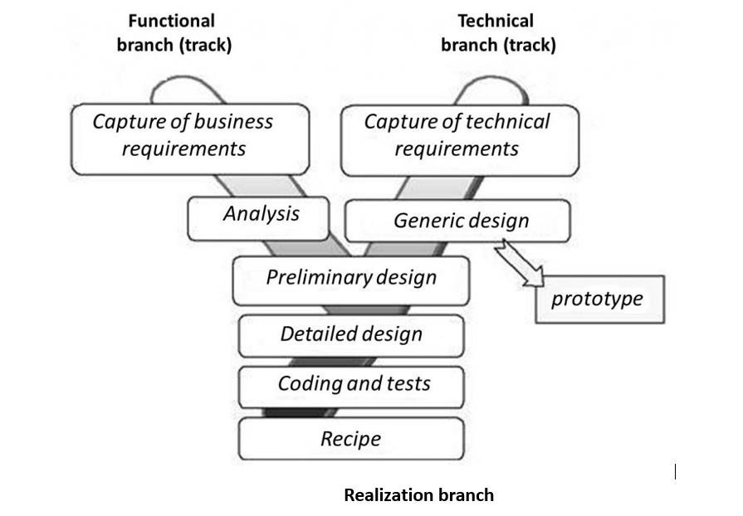

Methodology
2TUP

Slide 11
Methodology
It’s a modeling language.UML lets you use diagrams to represent how parts of a system work together.
2TUP stands for Two-Tracks Unified Process.
It’s a software development methodology that builds on the Unified Process (UP).

Slide 12
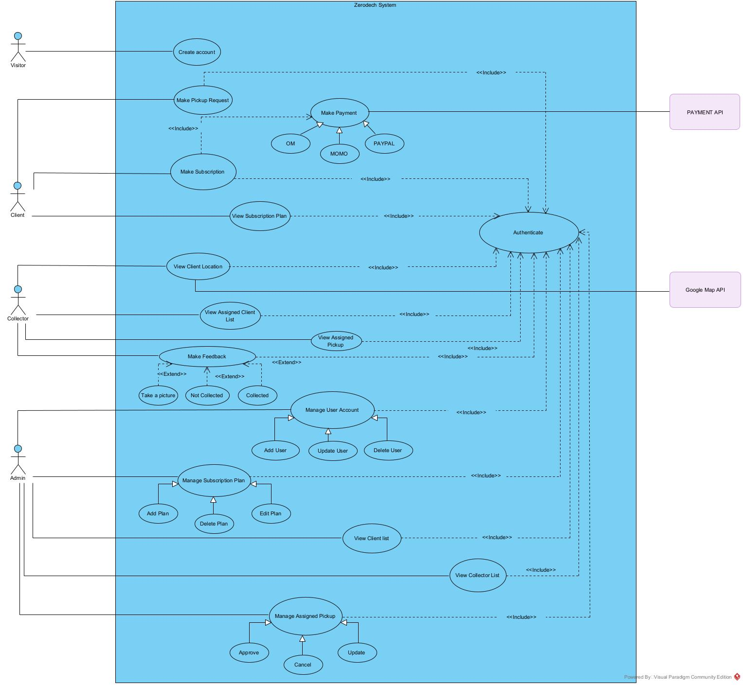
Zerodech GENERAL USE CASE DIAGRAM

Slide 13
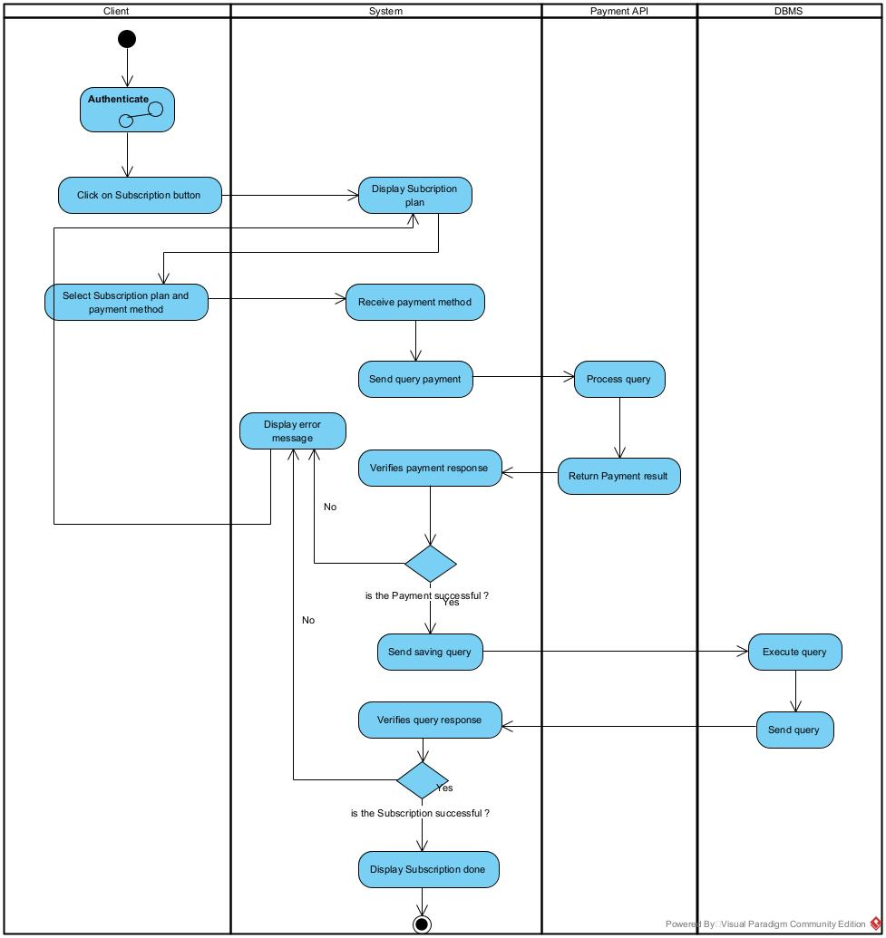
Make Subscription Activity Diagram

Slide 14
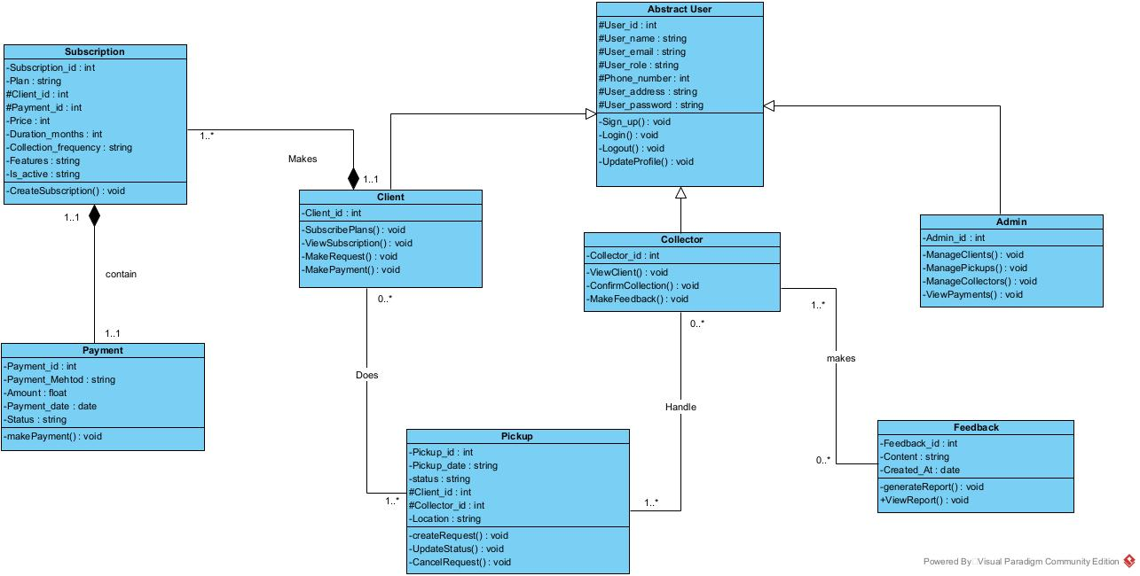
Zerodech Class Diagram

Slide 15
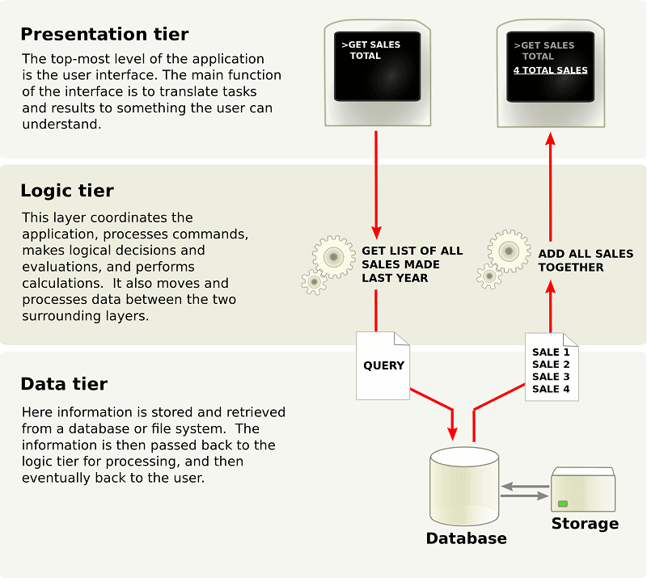
Methodology
N-tier Architecture
Technical branch
Capture of technical requirements
Generic design

Slide 16
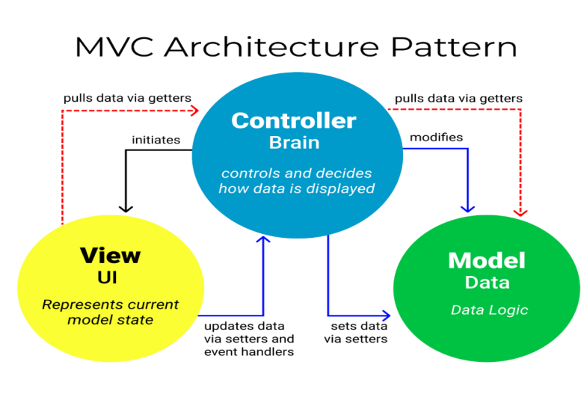
Methodology
Logical Architecture
Technical branch
Capture of technical requirements
Generic design

Slide 17






DEVELOPMENT TOOLS AND LANGUAGES

Slide 18


Demonstration
Zerodech App

Slide 19

Thanks!

